Slide 1
GRAPHS

Slide 2
Definition
A graph G consists of two sets
a finite, nonempty set of vertices V(G)
a finite, possible empty set of edges E(G)
G(V,E) represents a graph
An undirected graph is one in which the pair of vertices in a edge is unordered, (v0, v1) = (v1,v0)
A directed graph is one in which each edge is a directed pair of vertices, <v0, v1> != <v1,v0>
source
destination

Slide 3
Examples for Graph
0
0
0
1
2
1
2
1
3
3
4
5
6
G1
2
G2
complete graph
incomplete graph
G3
V(G1)={0,1,2,3} E(G1)={(0,1),(0,2),(0,3),(1,2),(1,3),(2,3)}
V(G2)={0,1,2,3,4,5,6} E(G2)={(0,1),(0,2),(1,3),(1,4),(2,5),(2,6)}
V(G3)={0,1,2} E(G3)={<0,1>,<1,0>,<1,2>}
complete undirected graph: n(n-1)/2 edges
complete directed graph: n(n-1) edges

Slide 4
Complete Graph
A complete graph is a graph that has the maximum number of edges
for undirected graph with n vertices, the maximum number of edges is n(n-1)/2
for directed graph with n vertices, the maximum number of edges is n(n-1)
example: G1 is a complete graph

Slide 5
Adjacent and Incident
If (v0, v1) is an edge in an undirected graph,
v0 and v1 are adjacent
The edge (v0, v1) is incident on vertices v0 and v1
If <v0, v1> is an edge in a directed graph
v0 is adjacent to v1, and v1 is adjacent from v0
The edge <v0, v1> is incident on v0 and v1

Slide 6
Subgraph and Path
A subgraph of G is a graph G’ such that V(G’) is a subset of V(G) and E(G’) is a subset of E(G)
A path from vertex vp to vertex vq in a graph G, is a sequence of vertices, vp, vi1, vi2, ..., vin, vq, such that (vp, vi1), (vi1, vi2), ..., (vin, vq) are edges in an undirected graph
The length of a path is the number of edges on it

Slide 7
Examples:::Subgraph
0
0
0
1
2
0
1
2
1
2
3
1
2
3
3
G1
(i) (ii) (iii) (iv)
Some of the subgraph of G₁

Slide 8
Examples:::Subgraph
0
0
0
0
1
1
1
2
2
(i) (ii) (iii)
G2

Slide 9
Simple Path and Cycle
A simple path is a path in which all vertices, except possibly the first and the last, are distinct
A cycle is a simple path in which the first and the last vertices are the same

Slide 10
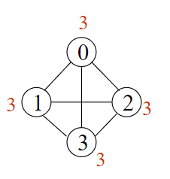
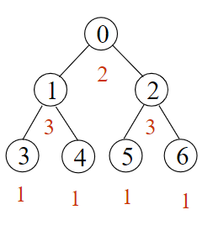
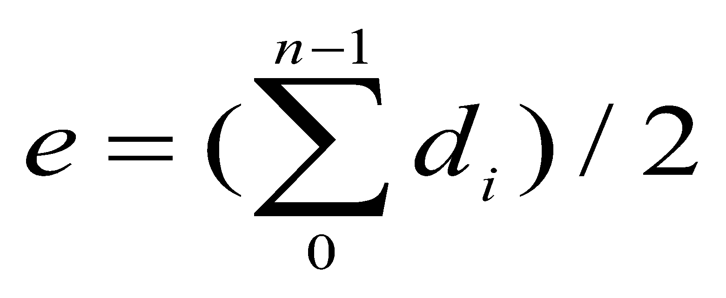
Degree
The degree of a vertex is the number of edges incident to that vertex in an undirected graph
if di is the degree of a vertex i in a graph G with n vertices and e edges, the number of edges is

Slide 11
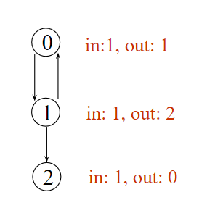
Degree
For directed graph,
the in-degree of a vertex v is the number of edges that have v as the destination
the out-degree of a vertex v is the number of edges that have v as the source

Slide 12
ADT for Graph
structure Graph is
objects: a nonempty set of vertices and a set of undirected edges, where each edge is a pair of vertices
functions: for all graph ∈ Graph, v, v₁ and v₂ ∈ Vertices
Graph Create()::=return an empty graph
Graph InsertVertex(graph, v)::= return a graph with v inserted. v has no incident edge.
Graph InsertEdge(graph, v1,v2)::= return a graph with new edge between v1 and v2
Graph DeleteVertex(graph, v)::= return a graph in which v and all edges incident to it are removed
Graph DeleteEdge(graph, v1, v2)::=return a graph in which the edge (v1, v2) is removed
Boolean IsEmpty(graph)::= if (graph==empty graph) return TRUE
else return FALSE
List Adjacent(graph,v)::= return a list of all vertices that are adjacent to v

Slide 13
Graph Representations
Adjacency Matrix
Adjacency Lists

Slide 14
Adjacency Matrix
Let G=(V,E) be a graph with n vertices.
The adjacency matrix of G is a two-dimensional n by n array
If the edge (vi, vj) is in E(G), adj_mat[i][j]=1
If there is no such edge in E(G), adj_mat[i][j]=0
The adjacency matrix for an undirected graph is symmetric; the adjacency matrix for a digraph need not be symmetric

Slide 15
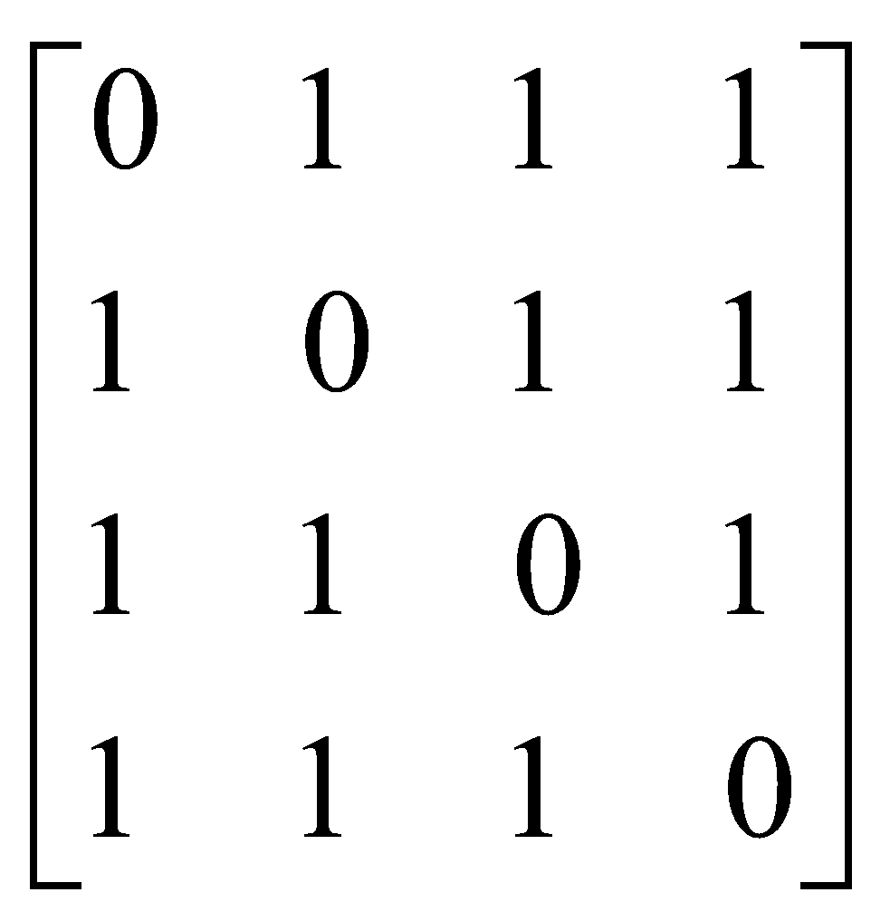
Examples for Adjacency Matrix
0
1
2
3
G1
The degree of a vertex is equal to the row sum

Slide 16
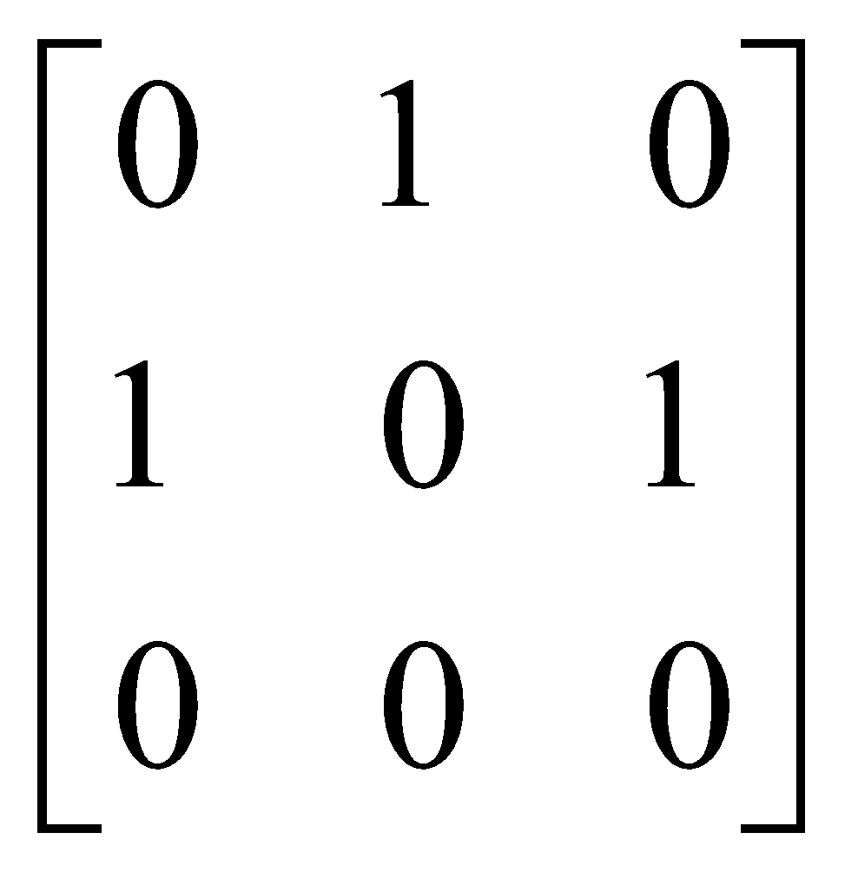
Examples for Adjacency Matrix
0
1
2
G2
For a digraph, the row sum is the out_degree, while the column sum is the in_degree

Slide 17
DEMO----Adjacency matrix representation
DIRECTED GRAPH----adjacency matrix representation
UNDIRECTED GRAPH----adjacency matrix representation

Slide 18
Adjacency Lists----Undirected Graph
0
0
1
2
3
1
2
3
0
2
3
1
2
0
1
3
3
0
1
2
G1
An undirected graph with n vertices and e edges ==> n head nodes and 2e list nodes

Slide 19

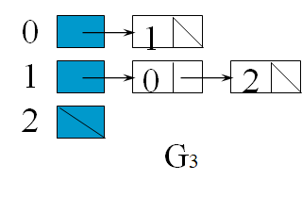
Adjacency Lists----Directed Graph

Slide 20
Interesting Operations
degree of a vertex in an undirected graph
# of nodes in adjacency list
out-degree of a vertex in a directed graph
# of nodes in its adjacency list
in-degree of a vertex in a directed graph
Little tricky
Need of inverse adjacency lists

Slide 21
Weighted edges
Edges of the graph can have some values (weights)
Weights may represent Distance or cost
Adjacency matrix or adjacency list will have this weights---cost adjacency matrix----cost adjacency lists
A graph with weighted edges is called as NETWORK

Slide 22
Some Graph Operations
Traversal Given G=(V,E) and vertex v, find all w∈V, such that w connects v.
Depth First Search (DFS) preorder tree traversal
Breadth First Search (BFS) level order tree traversal
Connected Components
Spanning Trees

Slide 23
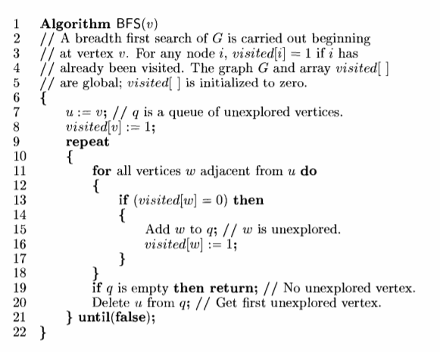
BFS

Slide 24
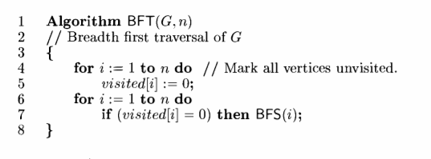
BFT

Slide 25
Pseudo code --BFS
void bfs(int v)
{
int i;
for (i=0;i<n;i++) // check all the vertices in the graph
{
if(a[v][i] != 0 && visited[i] == 0) // adjacent to v and not visited
{
r=r+1;
q[r]=i; // insert them into queue
visited[i]=1; // mark the vertex visited
printf("%d ",i);
}
}
f=f+1; // remove the vertex at front of the queue
if(f<=r) // as long as there are elements in the queue
bfs(q[f]); // peform bfs again on the vertex at front of the queue
}

Slide 26
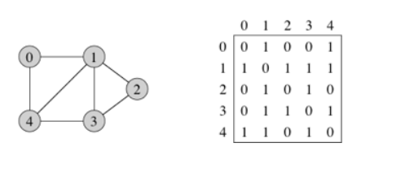
Example ---BFS
starting vertex---0

Slide 27
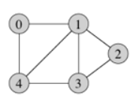
BFS(0)
 | 0 | 1 | 2 | 3 | 4
0 | 0 | 1 | 0 | 0 | 1
1 | 1 | 0 | 1 | 1 | 1
2 | 0 | 1 | 0 | 1 | 0
3 | 0 | 1 | 1 | 0 | 1
4 | 1 | 1 | 0 | 1 | 0
NODES | VISITED
0 | 1
1 | 0
2 | 0
3 | 0
4 | 0
QUEUE
RESULT | 0

Slide 28
 | 0 | 1 | 2 | 3 | 4
0 | 0 | 1 | 0 | 0 | 1
1 | 1 | 0 | 1 | 1 | 1
2 | 0 | 1 | 0 | 1 | 0
3 | 0 | 1 | 1 | 0 | 1
4 | 1 | 1 | 0 | 1 | 0
NODES | VISITED
0 | 1
1 | 1
2 | 0
3 | 0
4 | 0
QUEUE | 1
RESULT | 0 | 1

Slide 29
 | 0 | 1 | 2 | 3 | 4
0 | 0 | 1 | 0 | 0 | 1
1 | 1 | 0 | 1 | 1 | 1
2 | 0 | 1 | 0 | 1 | 0
3 | 0 | 1 | 1 | 0 | 1
4 | 1 | 1 | 0 | 1 | 0
NODES | VISITED
0 | 1
1 | 1
2 | 0
3 | 0
4 | 1
QUEUE | 1 | 4
RESULT | 0 | 1 | 4

Slide 30
 | 0 | 1 | 2 | 3 | 4
0 | 0 | 1 | 0 | 0 | 1
1 | 1 | 0 | 1 | 1 | 1
2 | 0 | 1 | 0 | 1 | 0
3 | 0 | 1 | 1 | 0 | 1
4 | 1 | 1 | 0 | 1 | 0
NODES | VISITED
0 | 1
1 | 1
2 | 0
3 | 0
4 | 1
remove from queue
QUEUE | 1 | 4
RESULT | 0 | 1 | 4

Slide 31
BFS(1)
 | 0 | 1 | 2 | 3 | 4
0 | 0 | 1 | 0 | 0 | 1
1 | 1 | 0 | 1 | 1 | 1
2 | 0 | 1 | 0 | 1 | 0
3 | 0 | 1 | 1 | 0 | 1
4 | 1 | 1 | 0 | 1 | 0
NODES | VISITED
0 | 1
1 | 1
2 | 0
3 | 0
4 | 1
QUEUE | 4
RESULT | 0 | 1 | 4

Slide 32
 | 0 | 1 | 2 | 3 | 4
0 | 0 | 1 | 0 | 0 | 1
1 | 1 | 0 | 1 | 1 | 1
2 | 0 | 1 | 0 | 1 | 0
3 | 0 | 1 | 1 | 0 | 1
4 | 1 | 1 | 0 | 1 | 0
NODES | VISITED
0 | 1
1 | 1
2 | 1
3 | 0
4 | 1
QUEUE | 4 | 2
RESULT | 0 | 1 | 4 | 2

Slide 33
 | 0 | 1 | 2 | 3 | 4
0 | 0 | 1 | 0 | 0 | 1
1 | 1 | 0 | 1 | 1 | 1
2 | 0 | 1 | 0 | 1 | 0
3 | 0 | 1 | 1 | 0 | 1
4 | 1 | 1 | 0 | 1 | 0
NODES | VISITED
0 | 1
1 | 1
2 | 1
3 | 1
4 | 1
QUEUE | 4 | 2 | 3
RESULT | 0 | 1 | 4 | 2 | 3

Slide 34
 | 0 | 1 | 2 | 3 | 4
0 | 0 | 1 | 0 | 0 | 1
1 | 1 | 0 | 1 | 1 | 1
2 | 0 | 1 | 0 | 1 | 0
3 | 0 | 1 | 1 | 0 | 1
4 | 1 | 1 | 0 | 1 | 0
NODES | VISITED
0 | 1
1 | 1
2 | 1
3 | 1
4 | 1
remove from queue
QUEUE | 4 | 2 | 3
RESULT | 0 | 1 | 4 | 2 | 3

Slide 35
BFS(4)
 | 0 | 1 | 2 | 3 | 4
0 | 0 | 1 | 0 | 0 | 1
1 | 1 | 0 | 1 | 1 | 1
2 | 0 | 1 | 0 | 1 | 0
3 | 0 | 1 | 1 | 0 | 1
4 | 1 | 1 | 0 | 1 | 0
NODES | VISITED
0 | 1
1 | 1
2 | 1
3 | 1
4 | 1
QUEUE | 2 | 3
RESULT | 0 | 1 | 4 | 2 | 3

Slide 36
 | 0 | 1 | 2 | 3 | 4
0 | 0 | 1 | 0 | 0 | 1
1 | 1 | 0 | 1 | 1 | 1
2 | 0 | 1 | 0 | 1 | 0
3 | 0 | 1 | 1 | 0 | 1
4 | 1 | 1 | 0 | 1 | 0
NODES | VISITED
0 | 1
1 | 1
2 | 1
3 | 1
4 | 1
QUEUE | 2 | 3
RESULT | 0 | 1 | 4 | 2 | 3

Slide 37
 | 0 | 1 | 2 | 3 | 4
0 | 0 | 1 | 0 | 0 | 1
1 | 1 | 0 | 1 | 1 | 1
2 | 0 | 1 | 0 | 1 | 0
3 | 0 | 1 | 1 | 0 | 1
4 | 1 | 1 | 0 | 1 | 0
NODES | VISITED
0 | 1
1 | 1
2 | 1
3 | 1
4 | 1
remove from queue
QUEUE | 2 | 3
RESULT | 0 | 1 | 4 | 2 | 3

Slide 38
BFS(2)
 | 0 | 1 | 2 | 3 | 4
0 | 0 | 1 | 0 | 0 | 1
1 | 1 | 0 | 1 | 1 | 1
2 | 0 | 1 | 0 | 1 | 0
3 | 0 | 1 | 1 | 0 | 1
4 | 1 | 1 | 0 | 1 | 0
NODES | VISITED
0 | 1
1 | 1
2 | 1
3 | 1
4 | 1
QUEUE | 3
RESULT | 0 | 1 | 4 | 2 | 3

Slide 39
 | 0 | 1 | 2 | 3 | 4
0 | 0 | 1 | 0 | 0 | 1
1 | 1 | 0 | 1 | 1 | 1
2 | 0 | 1 | 0 | 1 | 0
3 | 0 | 1 | 1 | 0 | 1
4 | 1 | 1 | 0 | 1 | 0
NODES | VISITED
0 | 1
1 | 1
2 | 1
3 | 1
4 | 1
remove from queue
QUEUE | 3
RESULT | 0 | 1 | 4 | 2 | 3

Slide 40
BFS(3)
 | 0 | 1 | 2 | 3 | 4
0 | 0 | 1 | 0 | 0 | 1
1 | 1 | 0 | 1 | 1 | 1
2 | 0 | 1 | 0 | 1 | 0
3 | 0 | 1 | 1 | 0 | 1
4 | 1 | 1 | 0 | 1 | 0
NODES | VISITED
0 | 1
1 | 1
2 | 1
3 | 1
4 | 1
QUEUE
RESULT | 0 | 1 | 4 | 2 | 3

Slide 41
 | 0 | 1 | 2 | 3 | 4
0 | 0 | 1 | 0 | 0 | 1
1 | 1 | 0 | 1 | 1 | 1
2 | 0 | 1 | 0 | 1 | 0
3 | 0 | 1 | 1 | 0 | 1
4 | 1 | 1 | 0 | 1 | 0
NODES | VISITED
0 | 1
1 | 1
2 | 1
3 | 1
4 | 1
EMPTY queue
QUEUE
RESULT | 0 | 1 | 4 | 2 | 3

Slide 42
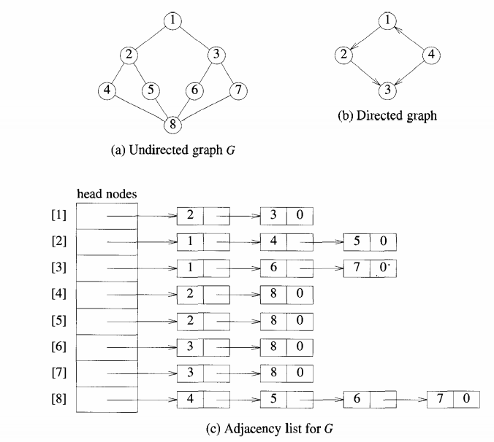
TRY IT!!
For Starting vertex—1:::
BFS-----UNDIRECTED ---1,2,3,4,5,6,78
BFS----DIRECTED ----1,2,3

Slide 43
BFS DEMO

Slide 44
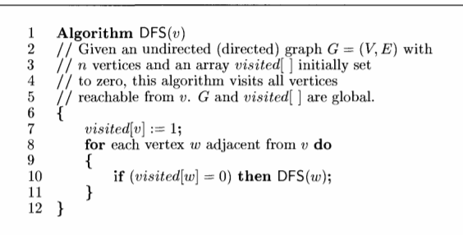
DFS

Slide 45
Pseudo code
void dfs(int v)
{
int i;
for (i=0;i<n;i++) // check all the vertices in the graph
{
if(a[v][i] != 0 && visited[i] == 0) // adjacent to v and not visited
{
visited[i]=1; // mark the vertex visited
printf("%d ",i);
dfs(i);
}
}
}

Slide 46
Example ---DFS
starting vertex---0

Slide 47
DFS(0)
 | 0 | 1 | 2 | 3 | 4
0 | 0 | 1 | 0 | 0 | 1
1 | 1 | 0 | 1 | 1 | 1
2 | 0 | 1 | 0 | 1 | 0
3 | 0 | 1 | 1 | 0 | 1
4 | 1 | 1 | 0 | 1 | 0
STACK
NODES | VISITED
0 | 1
1 | 0
2 | 0
3 | 0
4 | 0
RESULT | 0

Slide 48
 | 0 | 1 | 2 | 3 | 4
0 | 0 | 1 | 0 | 0 | 1
1 | 1 | 0 | 1 | 1 | 1
2 | 0 | 1 | 0 | 1 | 0
3 | 0 | 1 | 1 | 0 | 1
4 | 1 | 1 | 0 | 1 | 0
1
STACK
NODES | VISITED
0 | 1
1 | 01
2 | 0
3 | 0
4 | 0
RESULT | 0 | 1

Slide 49
DFS(1)
 | 0 | 1 | 2 | 3 | 4
0 | 0 | 1 | 0 | 0 | 1
1 | 1 | 0 | 1 | 1 | 1
2 | 0 | 1 | 0 | 1 | 0
3 | 0 | 1 | 1 | 0 | 1
4 | 1 | 1 | 0 | 1 | 0
2
STACK
NODES | VISITED
0 | 1
1 | 01
2 | 01
3 | 0
4 | 0
RESULT | 0 | 1 | 2

Slide 50
DFS(2)
 | 0 | 1 | 2 | 3 | 4
0 | 0 | 1 | 0 | 0 | 1
1 | 1 | 0 | 1 | 1 | 1
2 | 0 | 1 | 0 | 1 | 0
3 | 0 | 1 | 1 | 0 | 1
4 | 1 | 1 | 0 | 1 | 0
3
STACK
NODES | VISITED
0 | 1
1 | 01
2 | 01
3 | 01
4 | 0
RESULT | 0 | 1 | 2 | 3

Slide 51
DFS(3)
 | 0 | 1 | 2 | 3 | 4
0 | 0 | 1 | 0 | 0 | 1
1 | 1 | 0 | 1 | 1 | 1
2 | 0 | 1 | 0 | 1 | 0
3 | 0 | 1 | 1 | 0 | 1
4 | 1 | 1 | 0 | 1 | 0
4
STACK
NODES | VISITED
0 | 1
1 | 01
2 | 01
3 | 01
4 | 0 1
RESULT | 0 | 1 | 2 | 3 | 4

Slide 52
DFS(4)
 | 0 | 1 | 2 | 3 | 4
0 | 0 | 1 | 0 | 0 | 1
1 | 1 | 0 | 1 | 1 | 1
2 | 0 | 1 | 0 | 1 | 0
3 | 0 | 1 | 1 | 0 | 1
4 | 1 | 1 | 0 | 1 | 0
STACK
NODES | VISITED
0 | 1
1 | 01
2 | 01
3 | 01
4 | 0 1
RESULT | 0 | 1 | 2 | 3 | 4

Slide 53
DFS DEMO

Slide 54
Compare tree and Graph
BASIS FOR COMPARISON | TREE | GRAPH
Path | Only one between two vertices. | More than one path is allowed.
Root node | It has exactly one root node. | Graph doesn't have a root node.
Loops | No loops are permitted. | Graph can have loops.
Complexity | Less complex | More complex comparatively
Traversal techniques | Pre-order, In-order and Post-order. | Breadth-first search and depth-first search.
Number of edges | n-1 (where n is the number of nodes) | cannot be defined as it can vary from
Model type | Hierarchical | Network

Slide 55
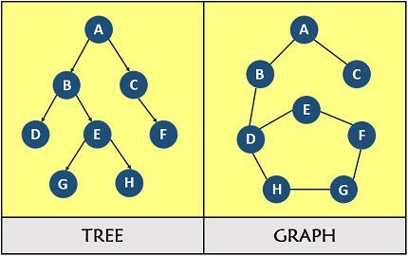
Compare tree and Graph

Slide 56
Compare BFS and DFS
BASIS FOR COMPARISON | BFS | DFS
Basic | Vertex-based algorithm | Edge-based algorithm
Data structure used to store the nodes | Queue | Stack
Memory consumption | Inefficient | Efficient
Structure of the constructed tree | Wide and short | Narrow and long
Traversing fashion | Oldest unvisited vertices are explored at first. | Vertices along the edge are explored in the beginning.
Optimality | Optimal for finding the shortest distance, not in cost. | Not optimal
Application | Used to find shortest path present in a graph. | Used to check whether the graph is acyclic and used in topological sort

Slide 57
Applications of Graph data structure
1.used to represent the flow of computation.
2.Used in Google maps for building transportation systems, where intersection of two(or more) roads are considered to be a vertex and the road connecting two vertices is considered to be an edge, thus their navigation system is based on the algorithm to calculate the shortest path between two vertices.
3.Used In Facebook for recommending friends. users are considered to be the vertices and if they are friends then there is an edge running between them. Facebook is an example of undirected graph.
4.Used In World Wide Web for page ranking computation. web pages are considered to be the vertices. There is an edge from a page u to other page v if there is a link of page v on page u. This is an example of Directed graph.
5.Used as Resource Allocation Graph where each process and resources are considered to be vertices. Edges are drawn from resources to the allocated process, or from requesting process to the requested resource. If this leads to any formation of a cycle then a deadlock will occur.

Slide 58
Minimum spanning tree
MINIMUM SPANNING TREE
Given a connected, undirected, weighted graph, a spanning tree of that graph is a sub graph which is a tree and connects all the vertices together. If weights are assigned, MST is one with the lowest total cost.
A graph can have many different spanning trees.
APPLICATIONS OF MST
Electric network
G/ € G , V(G/) = V(G)
Link/communication problems, all cities connected with minimum cost.

Slide 59
PRIM’s Algorithm
Algorithm:
Procedure Prim (G: weighted connected graph with n vertices)
{
T= a minimum weighted edge
For i = 1 to n-2
Begin
{
E = an edge of minimum weight incident to a vertex in T and not forming a cycle in T if added in T.
T = T with e added
}
End
Return (T)
}

Slide 60
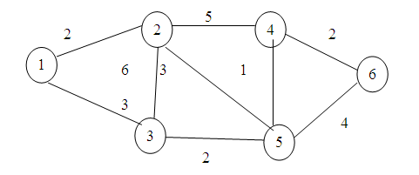
Prim’s algorithm

Slide 61
Kruskal’s Algorithm
Algorithm (G: weighted connected graph with n vertices)
{
T = ø
While t has less than n-1 edges and ( E ≠ 0 ) do
{
Choose an edge (v, w) from E of lowest cost;
Delete v, w from E;
If (v, w) does not create a cycle in T , then add (v, w) to T;
Else
Discard (v, w);
}
}

Slide 62
